Slide 1
Port Simulation and Pathfinding Comparison
Blue Team: Amy Charland, Lalith Koneru, Mahmoud Elbatouty, Vivek Advani
Notes:
Sources:
Draft presentation and outline supplied in the project repository.
https://github.com/acharland1/CIS5930_CourseProject/blob/main/README.md

Slide 2
Project Goals
Compare pathfinding methods to determine which completes deliveries most efficiently in each simulated scenario.
Test fleets of 20, 25, and 30 AGVs under the same workloads and operating rules.
Measure delivery task efficiency, vehicle waiting time, deadlock frequency, and computation cost using repeatable experiments.
Notes:
Sources:
Draft presentation and outline supplied in the project repository.
https://github.com/acharland1/CIS5930_CourseProject/blob/main/README.md
https://github.com/acharland1/CIS5930_CourseProject/blob/main/docs/implementation.md

Slide 3
Project Explanation
A 2D simulation models automated guided vehicles (AGVs) moving containers through a maritime port.
Vehicles collect containers at quay loading pads, deliver them to yard unloading pads, and return to parking after the work ends.
Three planners control the same environment so we can compare how they handle shared roads and competing vehicles.
The visual demo shows movement, routes, and reasons for waiting. Saved runs support comparison and exact replay.
Notes:
Sources:
Draft presentation and outline supplied in the project repository.
https://github.com/acharland1/CIS5930_CourseProject/blob/main/README.md
https://github.com/acharland1/CIS5930_CourseProject/blob/main/src/port_agv/env.py
https://github.com/acharland1/CIS5930_CourseProject/blob/main/src/port_agv/viewer.py

Slide 4
Environment
A synthetic grid is 40 cells wide and 30 cells tall, with directed roads and 30 private AGV parking bays.
Two quay loading pads and two yard unloading pads each have three physical queue cells.
AGVs start in parking, travel to a loader, and carry one container to an unloading pad.
Each cell holds one AGV. Vehicles move one adjacent road cell or wait each second. Opposing swaps are blocked.
Each pad serves one AGV at a time. Loading and unloading occupy the pad for a configured duration.
Notes:
The draft location wording is replaced with the implemented quay and yard terminology. Parking bays are distributed off the through lanes, not one central station. Geometry and handling times are synthetic.
Sources:
Draft presentation and outline supplied in the project repository.
https://github.com/acharland1/CIS5930_CourseProject/blob/main/README.md
https://github.com/acharland1/CIS5930_CourseProject/blob/main/src/port_agv/layout.py
https://github.com/acharland1/CIS5930_CourseProject/blob/main/src/port_agv/env.py

Slide 5
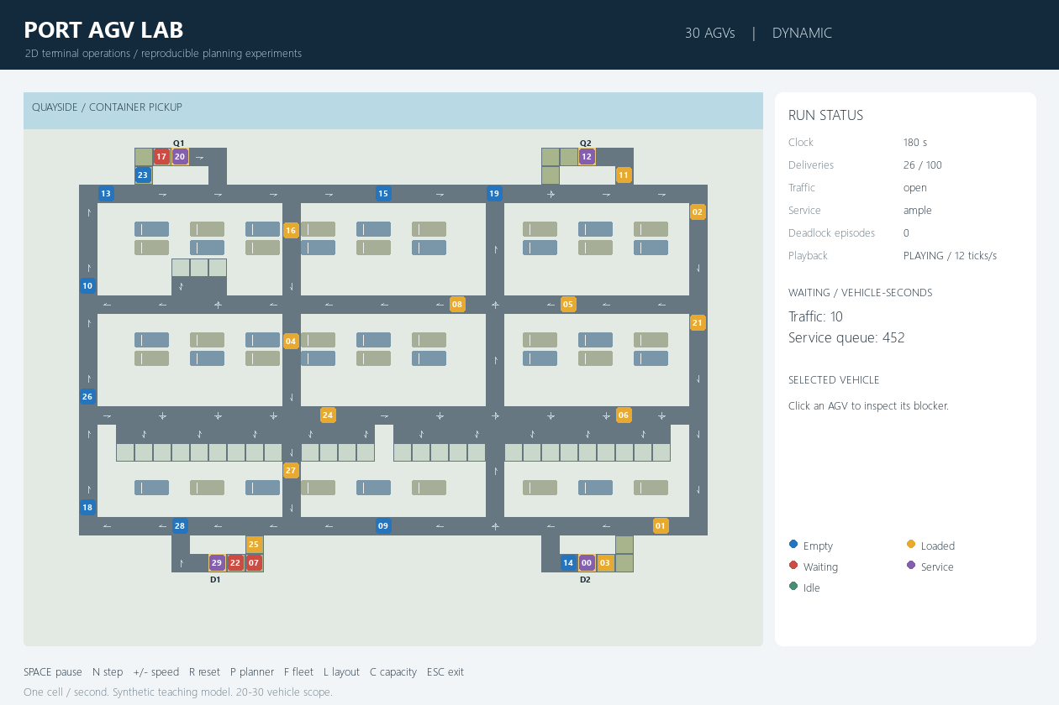
Environment
Quay Loading Pad
AGV Parking Bay
Yard Unloading Pad
Queue Cells
Notes:
The draft location wording is replaced with the implemented quay and yard terminology. Parking bays are distributed off the through lanes, not one central station. Geometry and handling times are synthetic.
Sources:
Draft presentation and outline supplied in the project repository.
https://github.com/acharland1/CIS5930_CourseProject/blob/main/README.md
https://github.com/acharland1/CIS5930_CourseProject/blob/main/src/port_agv/layout.py
https://github.com/acharland1/CIS5930_CourseProject/blob/main/src/port_agv/env.py

Slide 6
Configuration
Fleet size: 20, 25, or 30 AGVs.
Port layout: separate interior connectors in the open layout, or one shared two-way bottleneck.
Service setting: 5-second handling for ample service or 20 seconds for constrained service.
Task count: number of required deliveries, normally 100.
Release interval: time between new tasks, normally 2 seconds.
Maximum ticks: simulation time limit. One tick equals one second.
Rolling horizon: how far reservations look ahead, normally 10 ticks.
Deadlock ticks: minimum no-progress period before checking a persistent blocked cycle, normally 20.
Seed: reproduces the initial positions and task workload for fair comparisons.
Notes:
Service settings change handling duration, not the number of pads. Default maximum ticks is 10,000. Deadlock checking also requires a wait cycle with no immediate free escape or active service release.
Sources:
Draft presentation and outline supplied in the project repository.
https://github.com/acharland1/CIS5930_CourseProject/blob/main/src/port_agv/model.py
https://github.com/acharland1/CIS5930_CourseProject/blob/main/src/port_agv/layout.py
https://github.com/acharland1/CIS5930_CourseProject/blob/main/README.md

Slide 7
Planners
The demo compares three options: Dynamic Priority, Fixed Priority, and Rolling Horizon Reservations.
All three aim to complete deliveries efficiently while following the same traffic and service rules.
Each planner has global information about vehicles and roads. A central controller coordinates the fleet.
The current demo uses explicit planning algorithms. Reinforcement learning is a future extension.
Notes:
Sources:
Draft presentation and outline supplied in the project repository.
https://github.com/acharland1/CIS5930_CourseProject/blob/main/src/port_agv/planners.py
https://github.com/acharland1/CIS5930_CourseProject/blob/main/src/port_agv/env.py

Slide 8
Metrics
Completed deliveries: number of tasks finished before the run ends.
Average task delivery time: mean time from release to delivery for completed tasks.
Vehicle waiting time: traffic delays and service-queue delays, recorded separately.
Deadlock: persistent blocked groups with a confirmed wait cycle. Timeouts also capture unresolved stalls.
Computation cost: time spent planning decisions, including the mean and 95th percentile.
Notes:
Planning time excludes rendering and file writing. Completion averages alone can hide unfinished work. The conservative deadlock diagnostic can miss more complex stalls.
Sources:
Draft presentation and outline supplied in the project repository.
https://github.com/acharland1/CIS5930_CourseProject/blob/main/src/port_agv/runner.py
https://github.com/acharland1/CIS5930_CourseProject/blob/main/src/port_agv/report.py
https://github.com/acharland1/CIS5930_CourseProject/blob/main/src/port_agv/env.py

Slide 9
Future Plans
Reinforcement learning: train individual AGV or task-scheduling agents and compare them with the central planning baselines.
Independent scheduling: let separate agents assign tasks rather than relying on one dispatcher with global information.
Information loss and uncertainty: introduce delayed or missing instructions and random outcomes.
Battery life: track energy use and require charging stops after vehicles travel or work.
Dynamic road blockage: close roads during a run and evaluate rerouting and congestion recovery.
Notes:
These are proposed extensions, not implemented capabilities. Static closure-aware routing is present, but dynamic road-closure experiments are not part of the demonstrated validation.
Sources:
Draft presentation and outline supplied in the project repository.
https://github.com/acharland1/CIS5930_CourseProject/blob/main/README.md
https://github.com/acharland1/CIS5930_CourseProject/blob/main/docs/implementation.md

Slide 10
Fixed Priority Planner
Each vehicle follows a shortest route to its current goal, using the same routing logic as Dynamic Priority.
When vehicles compete for the same cell, the lower vehicle ID always receives priority.
The order stays fixed throughout the run, making this a simple comparison baseline.
Higher-ID vehicles may wait repeatedly when they compete for the same space. Waiting longer does not improve their priority.
The same environment checks prevent conflicting moves. Fixed priority can still produce deadlocks.
Notes:
Sources:
Draft presentation and outline supplied in the project repository.
https://github.com/acharland1/CIS5930_CourseProject/blob/main/src/port_agv/planners.py
https://github.com/acharland1/CIS5930_CourseProject/blob/main/src/port_agv/env.py

Slide 11
Dynamic Priority Planner
Each vehicle follows a shortest route to its current goal.
When vehicles compete for the same cell, the vehicle with the longest consecutive traffic wait receives priority.
Vehicle ID breaks ties. Moving or entering service resets the traffic-wait age.
This reduces repeated disadvantage compared with always giving lower IDs priority, but it cannot guarantee that all vehicles keep moving.
The environment checks the proposed moves and blocks unsafe conflicts before advancing the fleet.
Notes:
The shortest-route calculation does not avoid current vehicle occupancy. Service-related waiting does not increase dynamic traffic priority.
Sources:
Draft presentation and outline supplied in the project repository.
https://github.com/acharland1/CIS5930_CourseProject/blob/main/src/port_agv/planners.py
https://github.com/acharland1/CIS5930_CourseProject/blob/main/src/port_agv/env.py

Slide 12
Rolling Horizon Planner
The planner looks ahead through a short window, normally the next 10 simulation ticks.
It plans vehicles in traffic-wait priority order and reserves cells at specific future times.
Each search considers moves and waits while avoiding reserved cells and opposing edge crossings.
Only the first step executes. The planner then updates its plans using the new fleet state.
If it cannot find a feasible plan, the vehicle holds safely. These conservative holds can still cause backups and deadlocks.
Notes:
The implementation starts with safe full-window holds for every vehicle, replacing each only with a feasible route. Search is bounded to 5,000 expansions per vehicle. It does not guarantee optimality or deadlock freedom.
Sources:
Draft presentation and outline supplied in the project repository.
https://github.com/acharland1/CIS5930_CourseProject/blob/main/src/port_agv/planners.py
https://github.com/acharland1/CIS5930_CourseProject/blob/main/docs/implementation.md

Slide 13
Implementation Details
Python provides the shared model. PettingZoo exposes simultaneous vehicle actions, and Pygame displays the 2D demo.
One simulation core owns time, vehicle positions, task assignments, and container custody. Planners propose actions.
Every tick, the core resolves competing moves and commits the fleet update together. Independent checks monitor collisions and inventory.
Seeded workloads and saved decisions make experiments repeatable. Replay checks the resulting state against the saved run.
Logs and charts report outcomes and waiting causes. The recorded software check passed 35 automated tests.
Notes:
The architecture follows industrial plan sections 6–10 and 16–18 for task custody, deterministic timing, coordinator boundaries, and evidence, with the revised coursework grid fidelity. Validation is recorded on 2 November 2026.
Sources:
Draft presentation and outline supplied in the project repository.
https://github.com/acharland1/CIS5930_CourseProject/blob/main/src/port_agv/env.py
https://github.com/acharland1/CIS5930_CourseProject/blob/main/src/port_agv/runner.py
https://github.com/acharland1/CIS5930_CourseProject/blob/main/src/port_agv/viewer.py
https://github.com/acharland1/CIS5930_CourseProject/blob/main/docs/validation.md

Slide 14
Early Findings
30 AGVs, open layout, 100 deliveries, seed 0
Planner | Ample service Finish time (s) | Constrained service Finish time (s)
Dynamic Priority | 493 | 1,264
Fixed Priority | 493 | 1,264
Rolling Horizon | 524 | 1,305
Notes:
Recorded 2 November 2026. Table shows total simulated time to finish all 100 deliveries and park. Ample handling is 5 seconds per operation and constrained handling is 20 seconds. The active workload batch has 18 runs across fleets 20/25/30, two service settings, and three planners. Integration uses 20 tasks, a 2,000-tick cap, and both layouts. Across all 54 runs there are 36 completions and 18 timeouts. The full 360-run, ten-seed study has not been run.
Sources:
Draft presentation and outline supplied in the project repository.
https://github.com/acharland1/CIS5930_CourseProject/blob/main/examples/validation/open-workload-summary.csv
https://github.com/acharland1/CIS5930_CourseProject/blob/main/examples/validation/bottleneck-smoke-summary.csv
https://github.com/acharland1/CIS5930_CourseProject/blob/main/docs/validation.md

